Slide 1
Chapter 16B: The IPL process

Slide 2
Objectives
In this chapter you will learn:
  About the IPL process
  Why a system would be closed down and reloaded
  About extended up time for z/OS systems

Slide 3
Overview
IPL is “booting” the system
The address of the IPL volume and the IODF volume are required

Slide 4
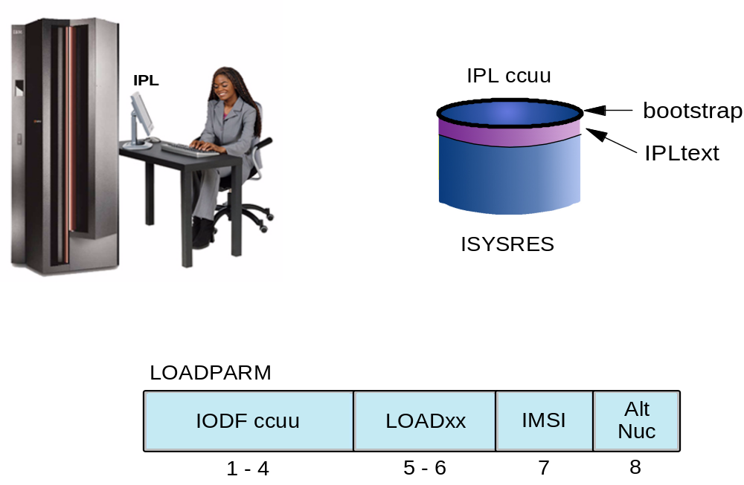
IPLing the machine

Slide 5
Initialization functions
When the operator supplies the parameters and tells the system to load the following happens:
  The bootstrap code on the IPL volume is loaded into storage at address 0 and control passed to it
  The bootstrap the reads the IPLTEXT program IEAIPL00 which is given control and the complex task of loading the system starts

Slide 6
IEAIPL00
IEAIPL00 prepares the system by clearing central storage to zeroes then defines storage areas for the master scheduler
SYS1.NUCLEUS is located and a series of modules loaded which construct the normal environment of control blocks and subsystems
The first part of the Nucleus Initialization Program is then loaded

Slide 7
Nucleus Initialization Program (NIP)
NIP sets up
  SQA
  PLPA
  FLPA
  MLPA
  the common service area CSA
  And starts the master scheduler

Slide 8
Master scheduler
The master address space starts all the other required address space and initializes the subsystems
Once JES is ready jobs can be started and VTAM and TSO will be started next.
The system is now available to do work

Slide 9
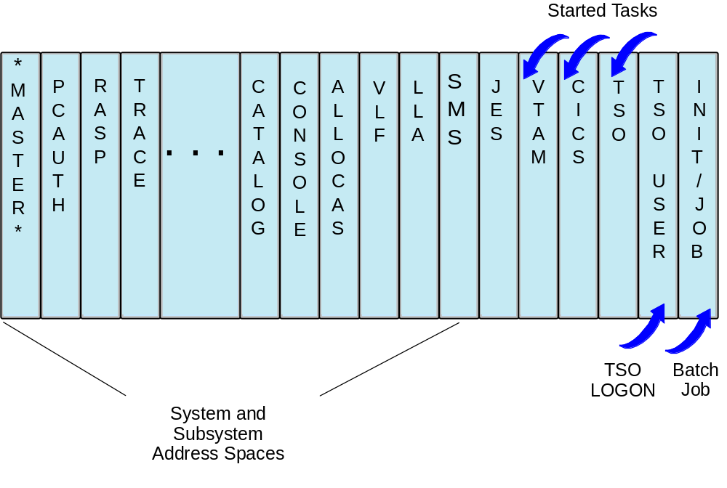
Virtual Storage Layout for Multiple Address Spaces

Slide 10
Address spaces
Many address spaces are created before JES and these each have special tasks
Each address space by default is allowed 2GB of virtual space
The private region below the 16MB line is usually around 10MB after the common area has been allowed for, depending on system set up and the size of installation modules in the LPA

Slide 11
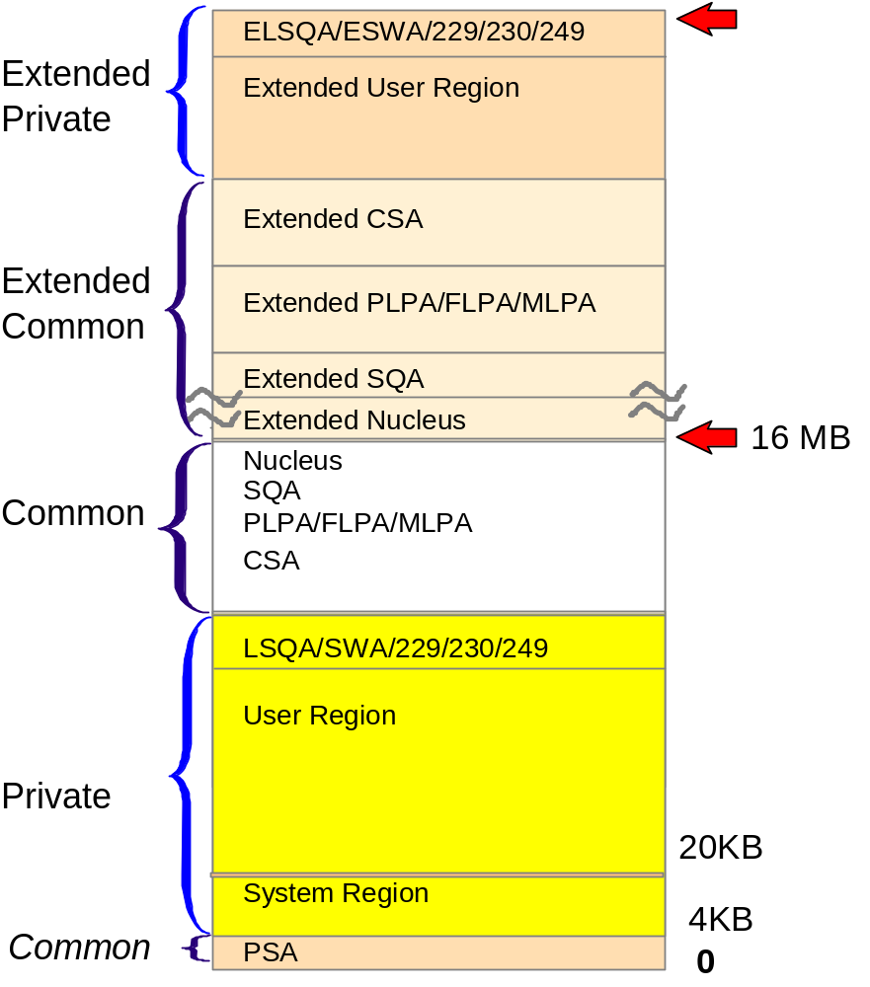
The 31-bit address space

Slide 12
Example 21-1 IPL checklist
To IPL the z/OS system, do the following:
1. Select the IPL option
2. IPL with the following parameters:
o If you receive the message IEA888A for the clock, enter:
=> r 00,u
o If you receive the message IXC4ZOD for XCF, enter:
=> r 00,i
o If you receive the message IXCZ48E for XCF data sets, enter:
=> r 00,u
3. When the $HASP426 SPECIFY OPTIONS message appears, enter the following to cold start JES2:
=> xx COLD,NOREQ
where xx is the reply ID of the console prompt.
Note: If the $HASP454, $HASP420, $HASP441, or $HASP870 messages appear, Enter a response of Y.

Slide 13
IPL Types
Cold start: PLPA is reloaded and VIO is cleared. This must happen when the contents of LPA have changed
Quick Start: PLPA is not reloaded but VIO is cleared. No changes were made to LPA but VIO needs to be refreshed
Warm Start: PLPA and VIO are retained from before the IPL allowing jobs to restart using journalled VIO data

Slide 14
Specifying information
From the hardware console the operator specifies the device address of the IODF file, selects the LOADxx member name and controls how the system will prompt during the IPL
If the IEASYSxx is not specified in the LOADxx member then the operator will be prompted to SPECIFY SYSTEM PARAMETERS

Slide 15
IPL Errors
If a required parmlib member has an error or is missing then the operator will be prompted
If the parameter cannot be corrected then the default can be accepted
If a default does not exist then the parameter may be cancelled or the IPL abandoned

Slide 16
Parmlib data sets
The parmlib concatenation is a set of up to 16 partitioned data sets defined in the LOADxx member
These contain the required members to supply the parameters for the system.
SYS1.PARMLIB is the 17th and default if no others are specified
IEASYSxx is mostly a director to other members

Slide 17
Shutting down the system
z/OS systems are designed to run continuously with potentially many months between reloads
Important workloads may require 24x365 availability
Systems are only shutdown when necessary usually for a change

Slide 18
System profiles
Test system
  Reloaded as required to satisfy the testing regime
High availability banking system
  Loaded very infrequently
  May be only yearly for software refresh
Outside influence may dictate reloads such as machine room power maintenance

Slide 19
Dynamic change
Over the last ten years much work has been done on z/OS and its predecessors so that many changes can be done dynamically

Slide 20
System shutdown
Each task needs to be shut down in the correct order
Usually this is done by an automation package
The final commands to remove automation and remove connections to other systems are performed by the operators

Slide 21
Summary
IPL was defined
The initialization process was explained
Types of IPL were discussed
VIO was explained
Extended up time and reasons for IPL were discussed

